Slide 1
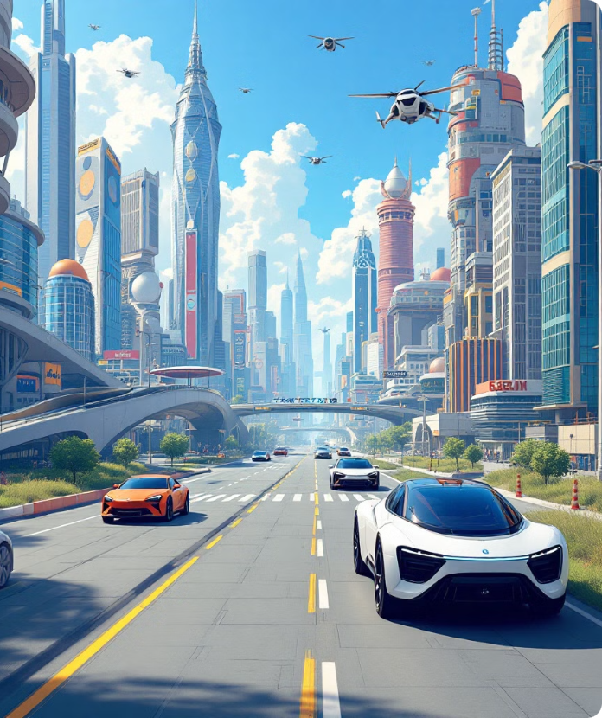
MobiFive – The Intelligent Future of Smart Mobility
Pioneering the convergence of Ai,IoT, and Robotics to revolutionize smart mobility.
Presented by MobiFive Innovators – Engineering
Tomorrow’s Mobility
Team: N. Jeruckshan (Leader),
K.Dilakshan,V.Puvishan
| Grade 9
| V/Omanthai C.C
| Vavuniya,Omanthai

Slide 2




Project Vision: Revolutionizing Autonomous Vehicles
AI-Powered
IoT-Enabled
Intelligent automation with advanced decision-making capabilities
Connected through intelligent sensors and real-time streaming
Dual-Mode Control
Bluetooth for short-range and WiFi for long-range operation

Slide 3






MobiFive's Five Core Functions
Autonomous Line Following
High-sensitivity IR sensors with PID control for precision navigation
Intelligent Object Avoidance
Ultrasonic sensors with adaptive rerouting for collision-free motion
Live Streaming
ESP32 Cam transmits HD video for real-time surveillance
Virtual Remote Control
Mobile app-based navigation via Bluetooth and WiFi
Voice Control And Ai Voice Assistant
Intelligent AI-powered voice assistant and seamless hands-free voice
control for effortless and interaction.

Slide 4
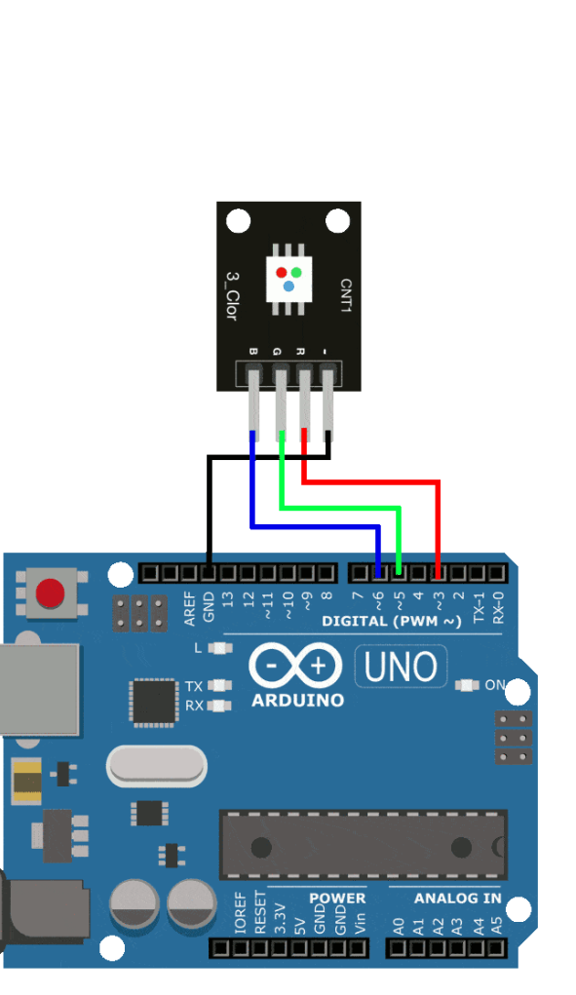
Advanced Engineering – Component Breakdown
Component
Function
7.4V Battery & Holder
High-performance power source
AMS 1117 Voltage Regulator
Stable power distribution
Arduino Uno
Brain of the system—executes logic & control
ESP32 Cam
Real-time video streaming and surveillance
Ultrasonic Sensor & Holder
Detects objects and prevents collisions
IR Sensor
Enables intelligent line-following navigation
Control Motors Using Arduino Outputs
L298nMotor Driver
HC-05 Bluetooth Module Send Bluetooth Inputs to iiiiiiiiiiiiiiiiiiiiiiiiiiiiiiiiiiiiiiiiiiiiiiiiiiiiiiiiiiiiiiArduino

Slide 5








The Technology Behind MobiFive
AI & Robotics
IoT & Wireless
Real-time autonomous decision-making and learning capabilities
Bluetooth for local control, WiFi for long-range access
Smart Navigation
Edge Computing
Precision control systems for intelligent mobility solutions
Faster data processing for immediate reactions to environment

Slide 6
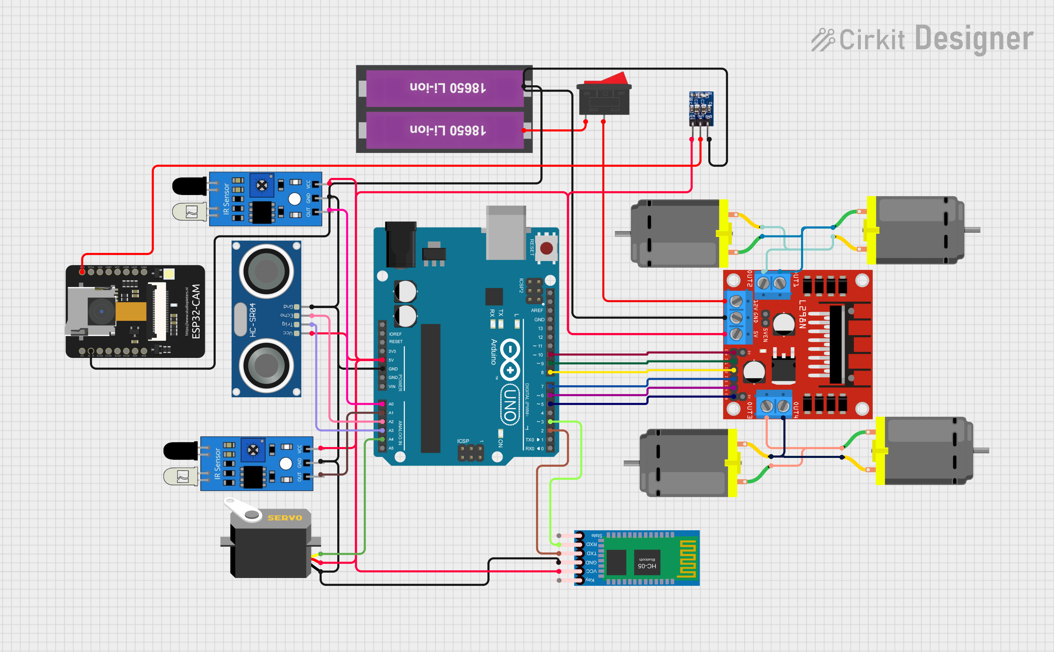
System Components & Circuit Diagram
Power
Sensing
Microcontroller & Other Modules
Body And Motor
7.4V Battery And Holder
Ultrasonic Sensor And Holder
4 Wheel Smart Car Chassis Kit
Switch
Arduino Uno
Breadboard
IR Sensor
ESP32 Cam
Servo Motor
AMS1117 Voltage Regulator
L298N Motor Driver
TT Motor
HC-05 Bluetooth Module

Slide 7










Future Enhancements
Swarm Robotics
Multi-vehicle coordination
Solar Power
Sustainable energy
App Enhancements
Offline Ai voice assistant
GPS Navigation
Full self-driving
AI Obstacle Detection
Machine learning algorithms

Slide 8
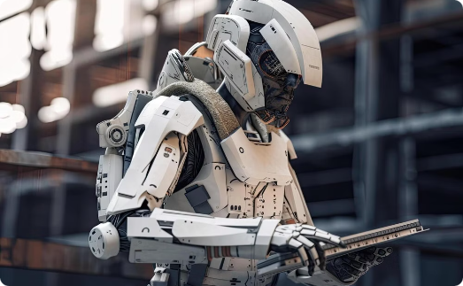

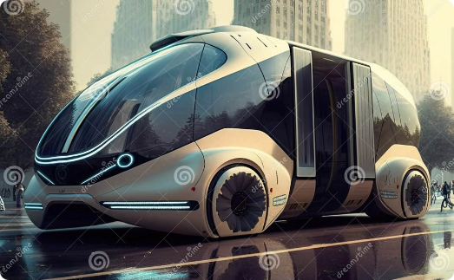
Engineering the Future of Mobility
Technological Leap
Perfect Harmony
Real-World Impact
MobiFive represents a breakthrough in intelligent automation and IoT-driven mobility solutions.
AI, IoT, and robotics working together to create a seamless autonomous experience.
From industrial automation to futuristic AI-driven transport, the future is now!

Slide 9


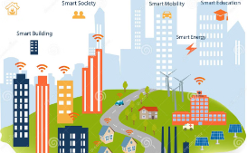


Thank You!
Smart Mobility
Innovative Technology
IoT Integration
Autonomous Vehicles
Connected transportation.
Driving progress.
Smart solutions.
The future of transport.
Thank you for watching this presentation.
Let me know if you have more improvements ideas! 😊
"Driving Innovation, Shaping the Future." 🚀

